Slide 1


ATLIQ MART
Promotional Sales Insights Report
Presented By: Joel Charles

Slide 2
AGENDA
Problem Statement
Insights
Ad-hoc Requests
Summary
Recommendations

Slide 3
PROBLEM STATEMENT
AtliQ Mart is a retail giant with over 50 supermarkets in the southern region of India. All their 50 stores ran a massive promotion during the Diwali 2023 and Sankranti 2024 (festive time in India) on their AtliQ branded products. Now the sales director wants to understand which promotions did well and which did not so they can make informed decisions for their next promotional period.

Slide 4
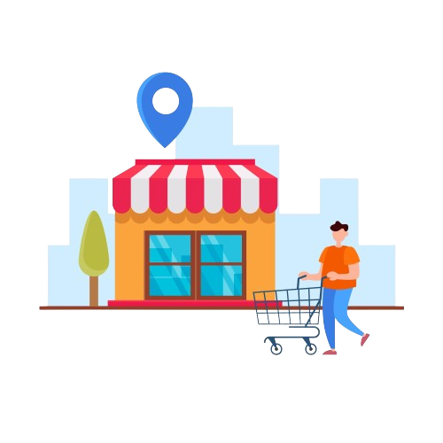
Store
Performance Analysis:

Slide 5
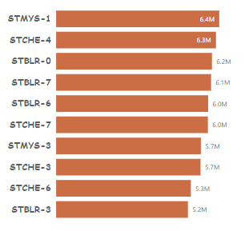
Top 10 Stores by Incremental Revenue
They saw the majority of their incremental revenue from the “500 Cashback” promotion.
The “500 Cashback” promotion accounts for an average of 60% of the total incremental revenue of the top ten stores.
From the top ten stores in terms of incremental revenue, four are stores located in Bangalore another four are stores in Chennai, the other two are stores in Mysuru.

Slide 6
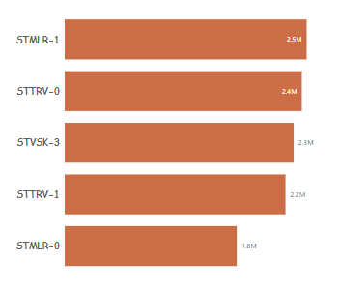
Bottom 5 Stores by Incremental Revenue
The bottom stores ironically didn’t perform badly, comparing them with other stores creates that narrative.
Their distribution of incremental revenue by promotion is very similar to stores with higher revenue, they even saw an average % increase in their revenue of 56%.
What separates the bottom and top stores is the volume of sales, the top store had more sales in terms of quantity sold per product and total quantity sold.
The bottom five stores saw an average of 2.4k units sold compared to an average of 6.7k units sold for the top five stores.

Slide 7
Stores Performance by City
Bangalore, Chennai and Hyderabad were the top three cities in terms of incremental revenue, with a total of 123 million in incremental which accounts for 59% of total incremental revenue.
Eight of the top ten stores were stores in Bangalore and Chennai while four of the bottom five stores were stores in Mangalore and Trivandrum.
There was an overall good performance when grouping the store’s incremental revenue by city, with an average % revenue increment of 59% among the ten cities.

Slide 8

Promotion
Type Analysis:

Slide 9
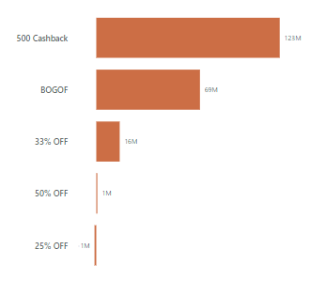
Incremental Revenue by Promotion Type
The “500 Cashback” promotion was the most successful promotion type racking up 123 million in incremental revenue.
“500 Cashback” and “BOGOF” were the most effective promotion types accounting for a staggering 92% of all incremental revenue.
The “50% OFF” and “25% OFF” promotions performed poorly, especially the latter resulting in a 1 million loss in sales.

Slide 10
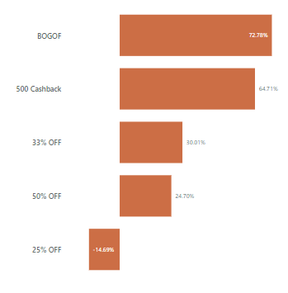
The “BOGOF” promotion produced the highest percentage increase in revenue after promotion, 72.8%, followed by “500 Cashback” with 64.7%.
“25% OFF” performed poorly seeing a negative return, with -14.7% increase in incremental revenue.

Slide 11

Product and
Category Analysis:

Slide 12
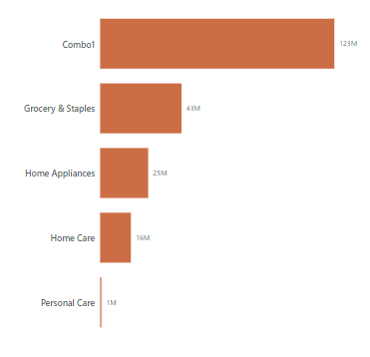
Incremental Revenue by Promotion Type
The “Combo1” category benefitted the most from the promotions, racking up 123 million in incremental revenue, which accounts for 59% of total incremental revenue.
“Grocery & Staples” produced 43 million in incremental revenue which is more than “Home Appliances”, “Home Care” and “Personal Care” put together
“Home Appliances” category had the highest increase in their revenue post promotion, 72.62%.
The impressive increase in the revenue post promotion of “Combo1” and “Home Appliances” is as a result of the promotion types associated with these products, all the products in the “Combo1” category where promoted using only the “500 Cashback” promo type while the other with the “BOGOF” promo type, and both promo types were the most effective in terms of incremental revenue and % revenue increase.

Slide 13
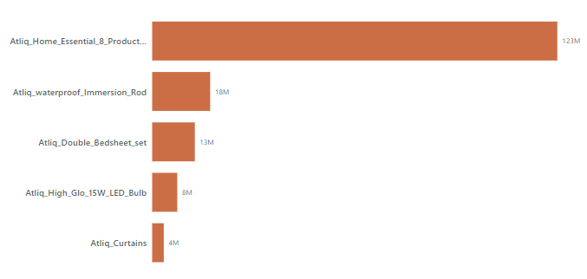
Top 5 Products by Incremental Revenue
The Top 5 products performed exceptionally, with the “Water proof immersion rod” performing the best in terms of % revenue increase, 72.7% while “home essential combo” recorded the highest incremental revenue post promotion.
The top 5 products racked up an incredible 185 million in incremental revenue, which accounts for 89% of the total incremental revenue.

Slide 14
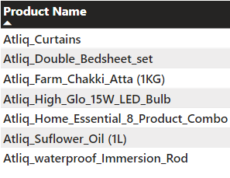
Products Most Significantly Impacted by Promotions
These are products that saw above 50% increase in their revenue after promotions.
The total incremental revenue from these seven products is 191 million.
These products are responsible for 92% of the total incremental revenue.

Slide 15

Poor Performing Products After Promotions
These are the two worst performing products after the promotions.
Both products have a negative profit and % Increment in revenue.
Both products were promoted using the “25% OFF” promotion type which was the most ineffective of the promotion and is like to be the cause of the negative profits of these products.

Slide 16
AD-HOC BUSINESS REQUESTS

Slide 17

1. Provide a list of products with a base price greater than 500 and that are featured in promo type of 'BOGOF' (Buy One Get One Free). This information will help us identify high-value products that are currently being heavily discounted, which can be useful for evaluating our pricing and promotion strategies.

Slide 18
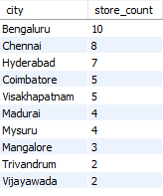
2. Generate a report that provides an overview of the number of stores in each city. The results will be sorted in descending order of store counts, allowing us to identify the cities with the highest store presence. The report includes two essential fields: city and store count, which will assist in optimizing our retail operations.

Slide 19

3. Generate a report that displays each campaign along with the total revenue generated before and after the campaign. The report includes three key fields:campaign_name, total_revenue(before_promotion), total_revenue(after_promotion). This report should help in evaluating the financial impact of our promotional campaigns.
note: values in millions

Slide 20
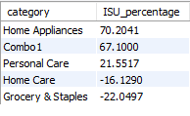
4. Produce a report that calculates the Incremental Sold Quantity (ISU%) for each category during the Diwali campaign. Additionally, provide rankings for the categories based on their ISU%. The report will include three key fields: category, isu%, and rank order. This information will assist in assessing the category-wise success and impact of the Diwali campaign on incremental sales.

Slide 21
SUMMARY
The “500 Cashback” and “BOGOF” were the most effective promotions and accounted for 92% of the total incremental revenue.
Bangalore and Chennai were the cities that generated the most incremental revenue, and they have the most stores, 8 and 7 respectively.
“25% OFF” promotion was not effective seeing a negative return, with -14.7% increase in incremental revenue, resulting in losses.
The “Home essential product combo” products was a hit racking in 59% of the total incremental revenue, only the 500 cash back promotion was used.
There was a considerable gap in terms of units sold between the stores with the higher sales and stores with the lower sales.
The least performing products were the ones promoted with the ineffective “25% OFF”.

Slide 22
RECOMMENDATIONS
The “25% OFF” and “50% OFF” promotions should be scrapped, resources should be angled towards the “BOGOF” and “500 Cashback” promotions.
Plan expansion in cities such as Mysuru and Mudurai, both have shown good numbers in terms of revenue, an saw an average of 60% increase in revenue among the two, but only have 4 stores each.
A strategy towards increasing the volume of sales in stores with less profit should be put in place.
The low-performing products post-promotion should be promoted with the more effective promotion types in the next promotion campaign.

Slide 23
THANK YOU

